Slide 1
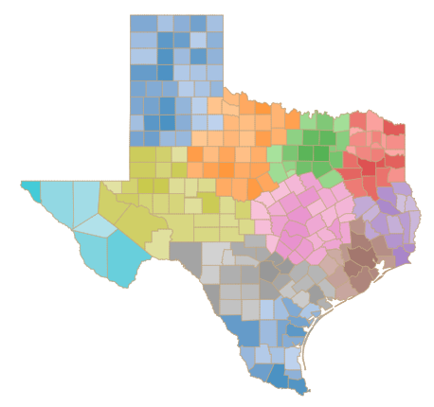
IST 718 Big Data Texas Adult Protective Services Operations Final Project
Michael Farrell Thomas Morey Cal Wardell

Slide 2
Question
What Does The Future Hold For Texas Protective Services?
The problem we are attempting to solve is can data provide the leadership with the necessary information needed to make operational and staffing decisions.
Which areas have the highest need?
What is the breakdown of the types/urgency of the cases?
Is one ethnicity or gender more likely to need services?

Slide 3
Why is this important?
Clientele population growing
Moving from rural to urban areas
Limited resouces
Funding
biennial budgeting
Staff
Limited by budget and employment environment
Facilities available

Slide 4
Datasets
Dataset 1 – Type of allegations
Attributes: County, Case ID , Allegation, Allegation Disposition
Size: 856,264 x 4
Dataset 2 - Demographics
Attributes: Region, OpenDate, ClientGender, ClientRace, ClientEthnicity, ClientMaritalStatus, AgeRange
Size: 497,026 x 7
Dataset 3 – Source of Report
Attributes: Fiscal Year, County, Region, Source of Report, Reporters
Size: 35,626 x 5
Dataset 4 – Pivot/Reference
Attributes: Allegation, Group
Size: 521 x 2

Slide 5
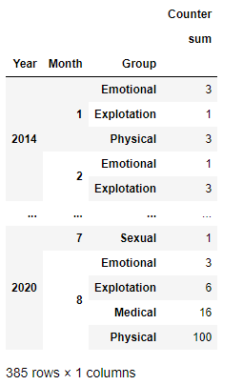
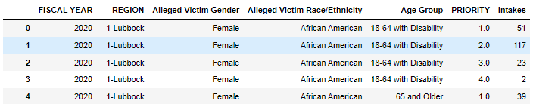
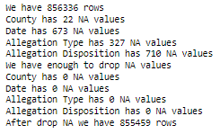
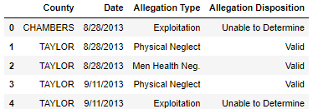
Data Exploration

Slide 6
Data Cleaning
After filtering out the NA values, we had 855,388 rows
We had bad spelling on counties so after filtering out counties we were not sure what county it was referencing we had 855,300 rows
We also had bad spelling for allegations so after filtering out all those we could not correctly group into one of the 5 categories(Physical, Mental, Sexual, Exploitation, and Emotional) we had 855,257 rows.

Slide 7
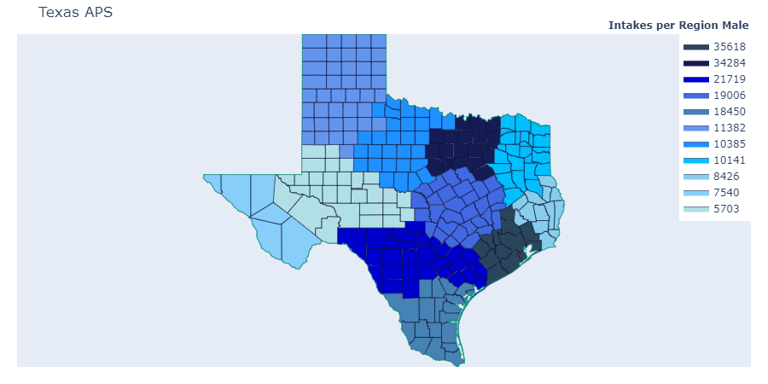
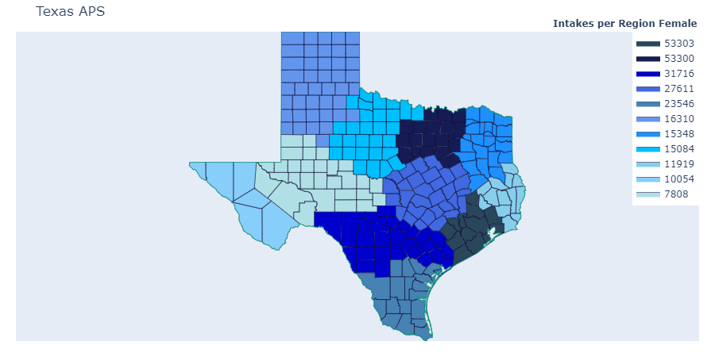
Texas APS

Slide 8
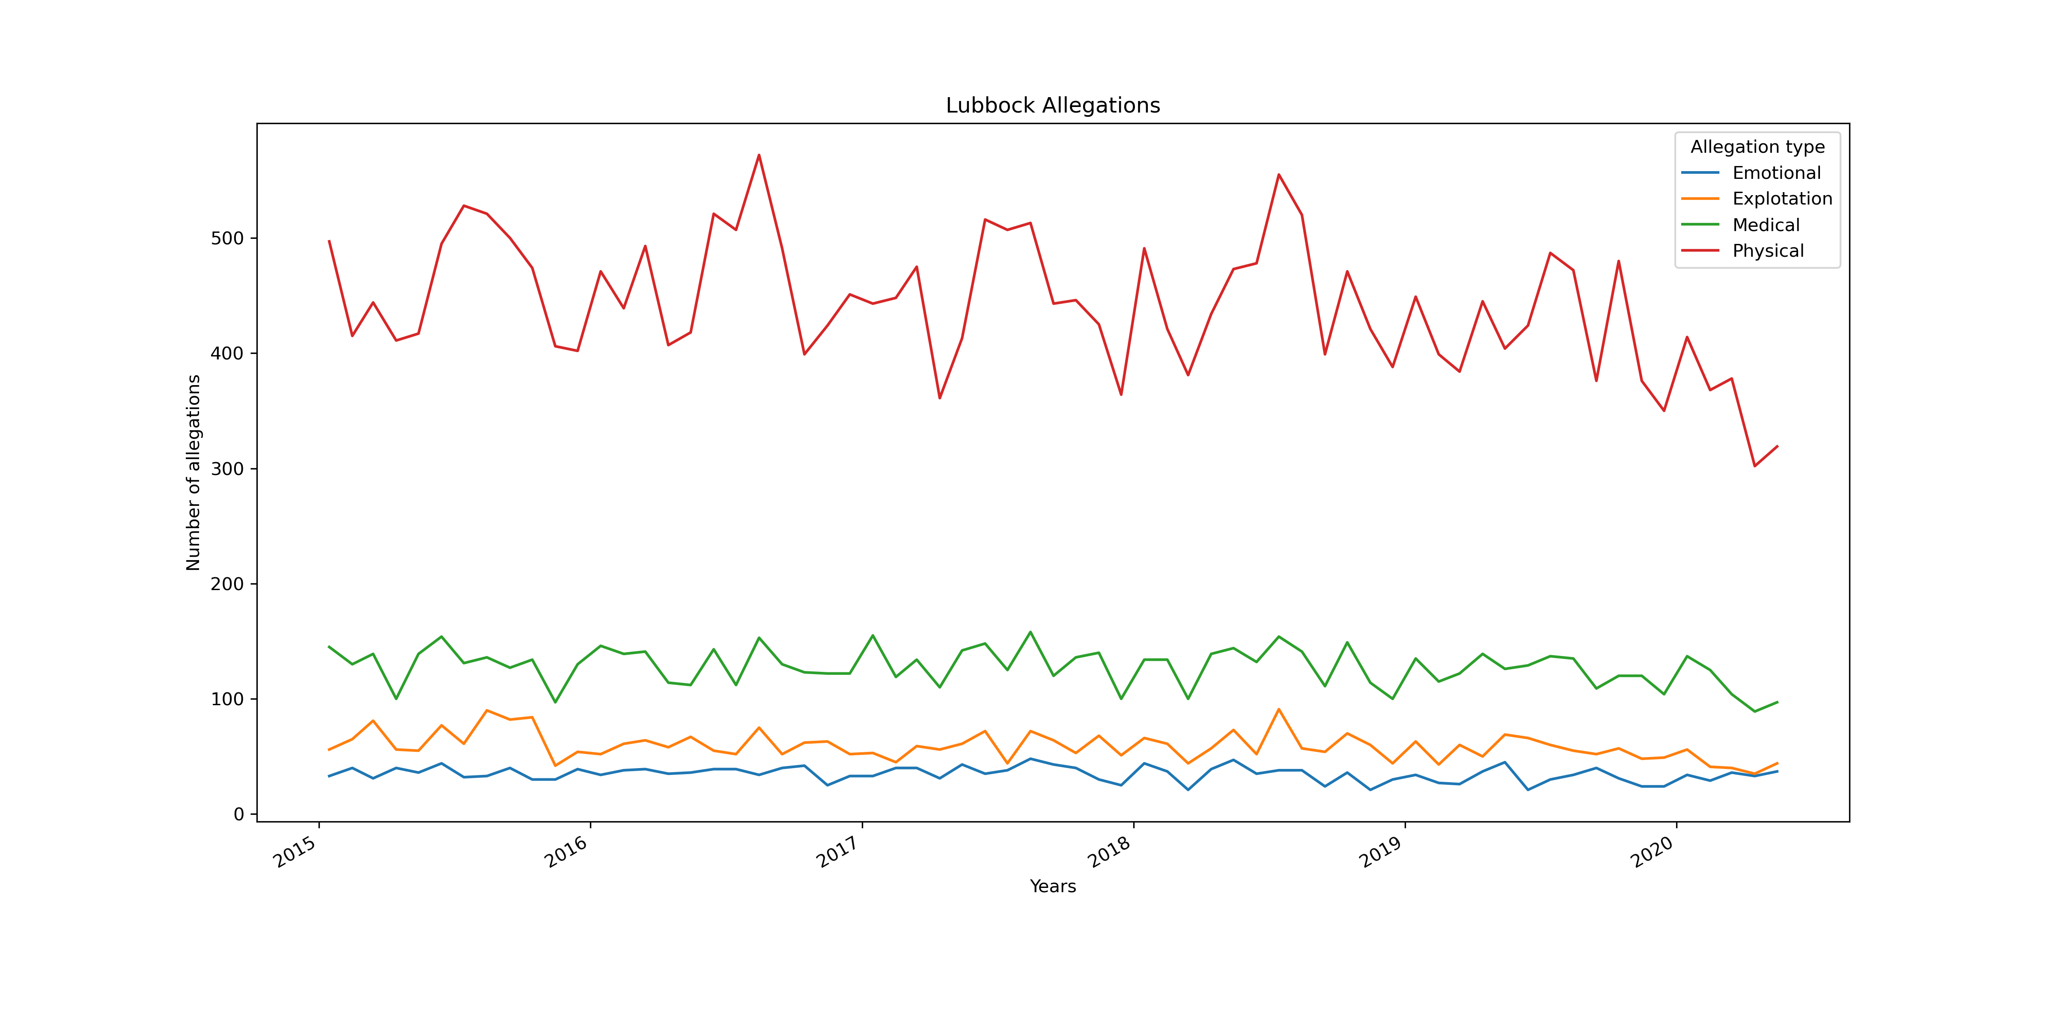
Analyses

Slide 9
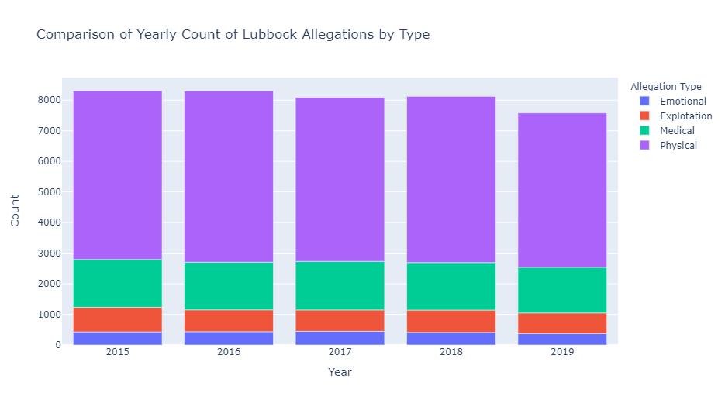
Analysis

Slide 10
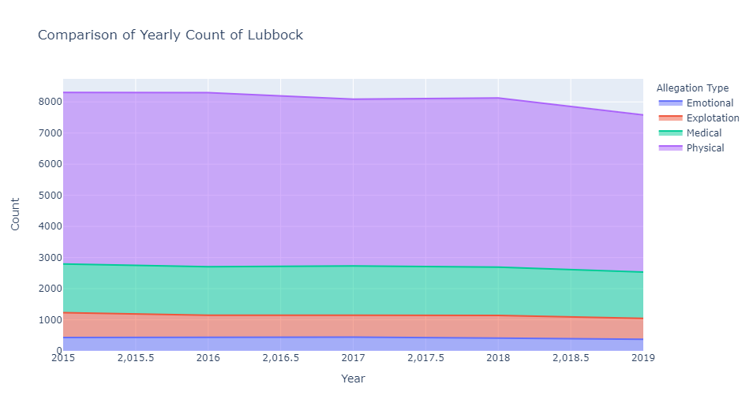
Analysis

Slide 11
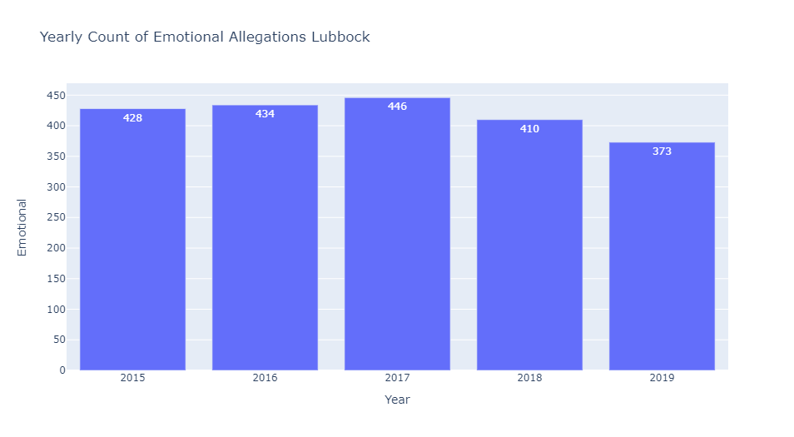
Analysis

Slide 12
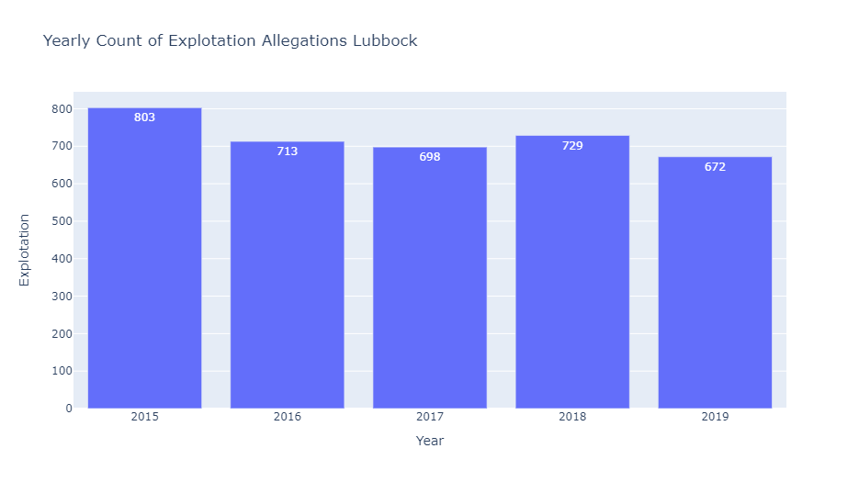
Analysis

Slide 13
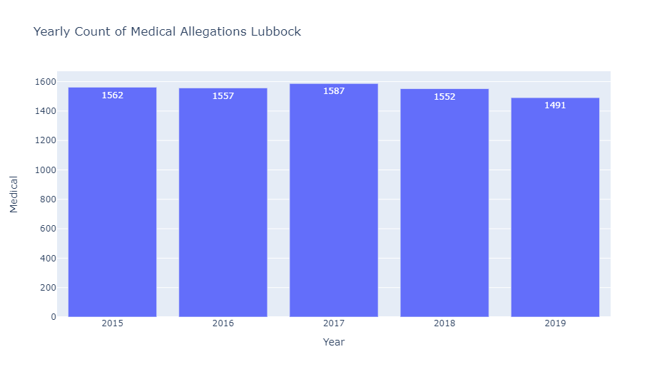
Analysis

Slide 14
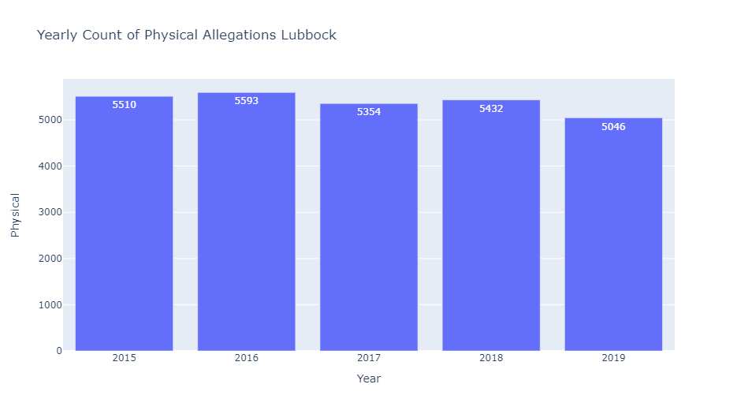
Analysis

Slide 15
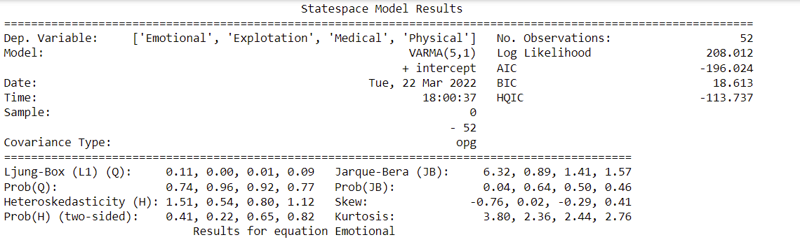
Lubbock Model Results

Slide 16
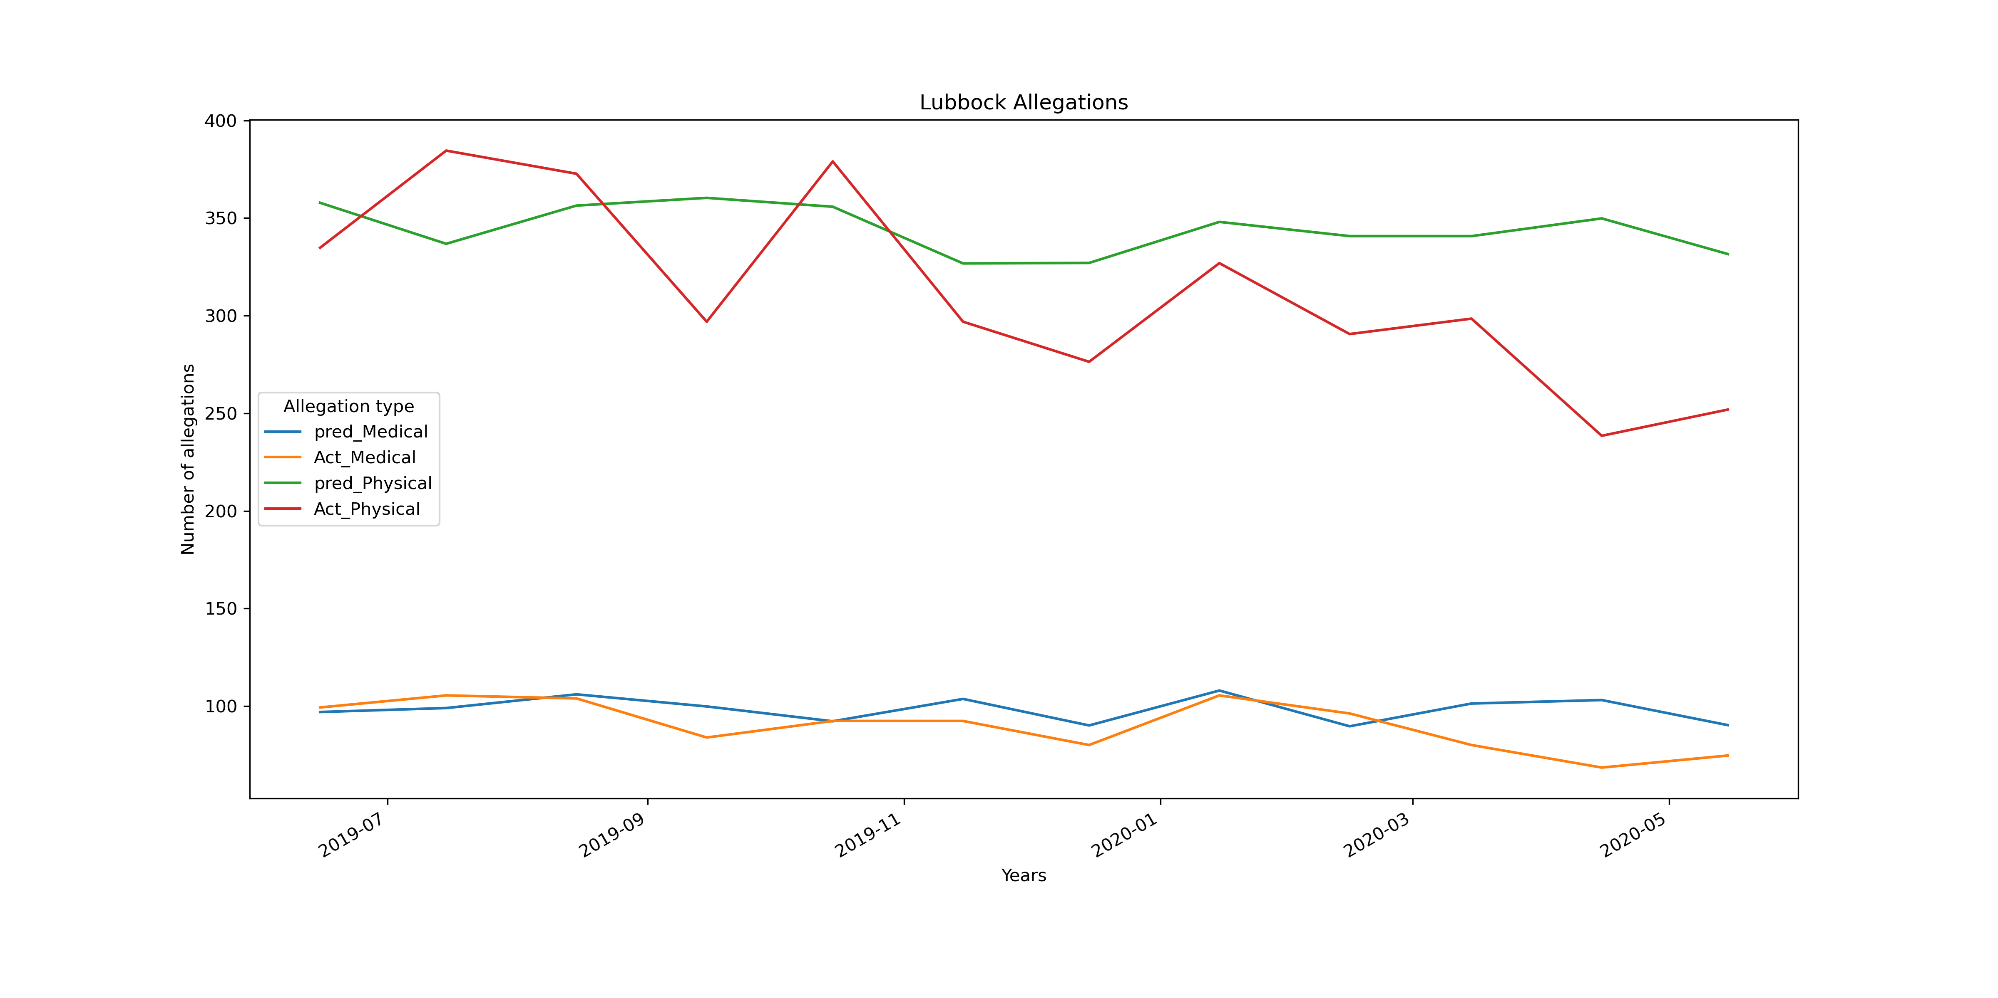
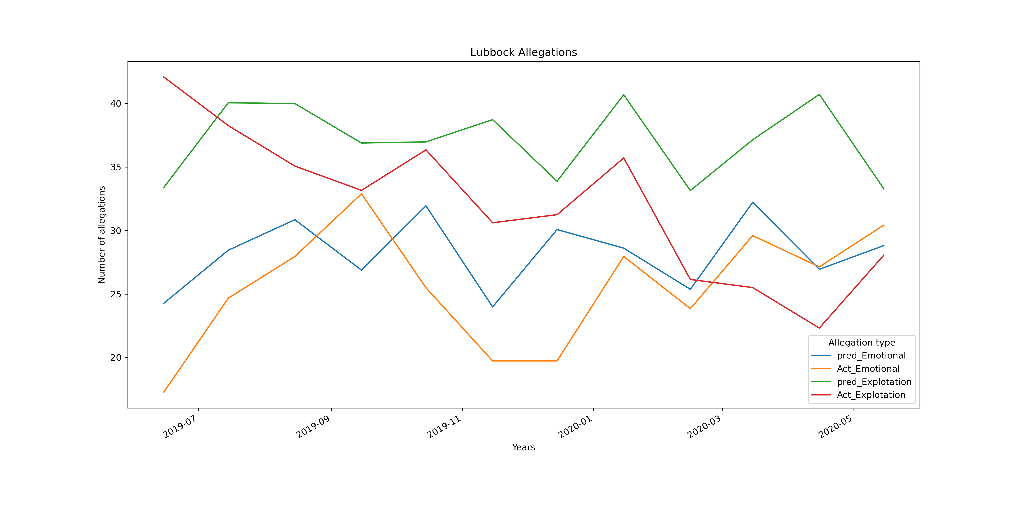
TESTING MODEL LUBBOCK

Slide 17
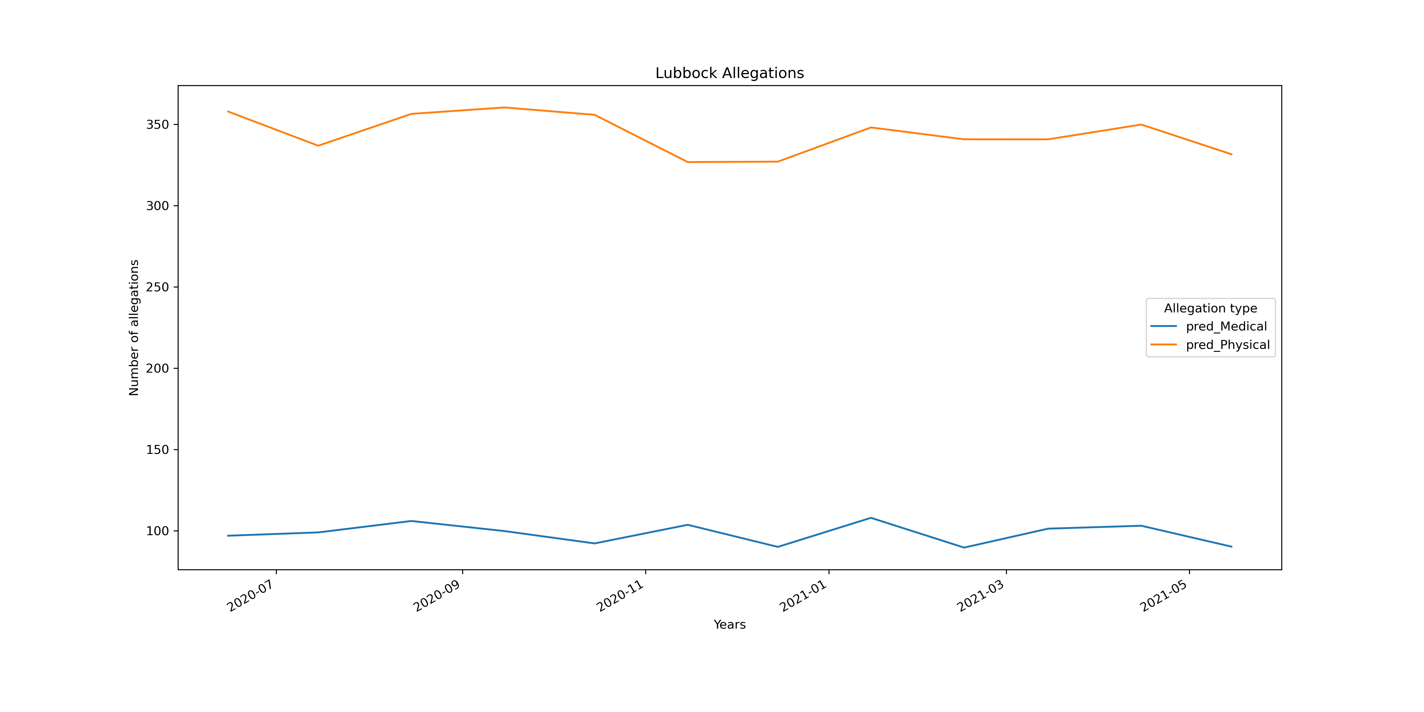
Forecasting

Slide 18
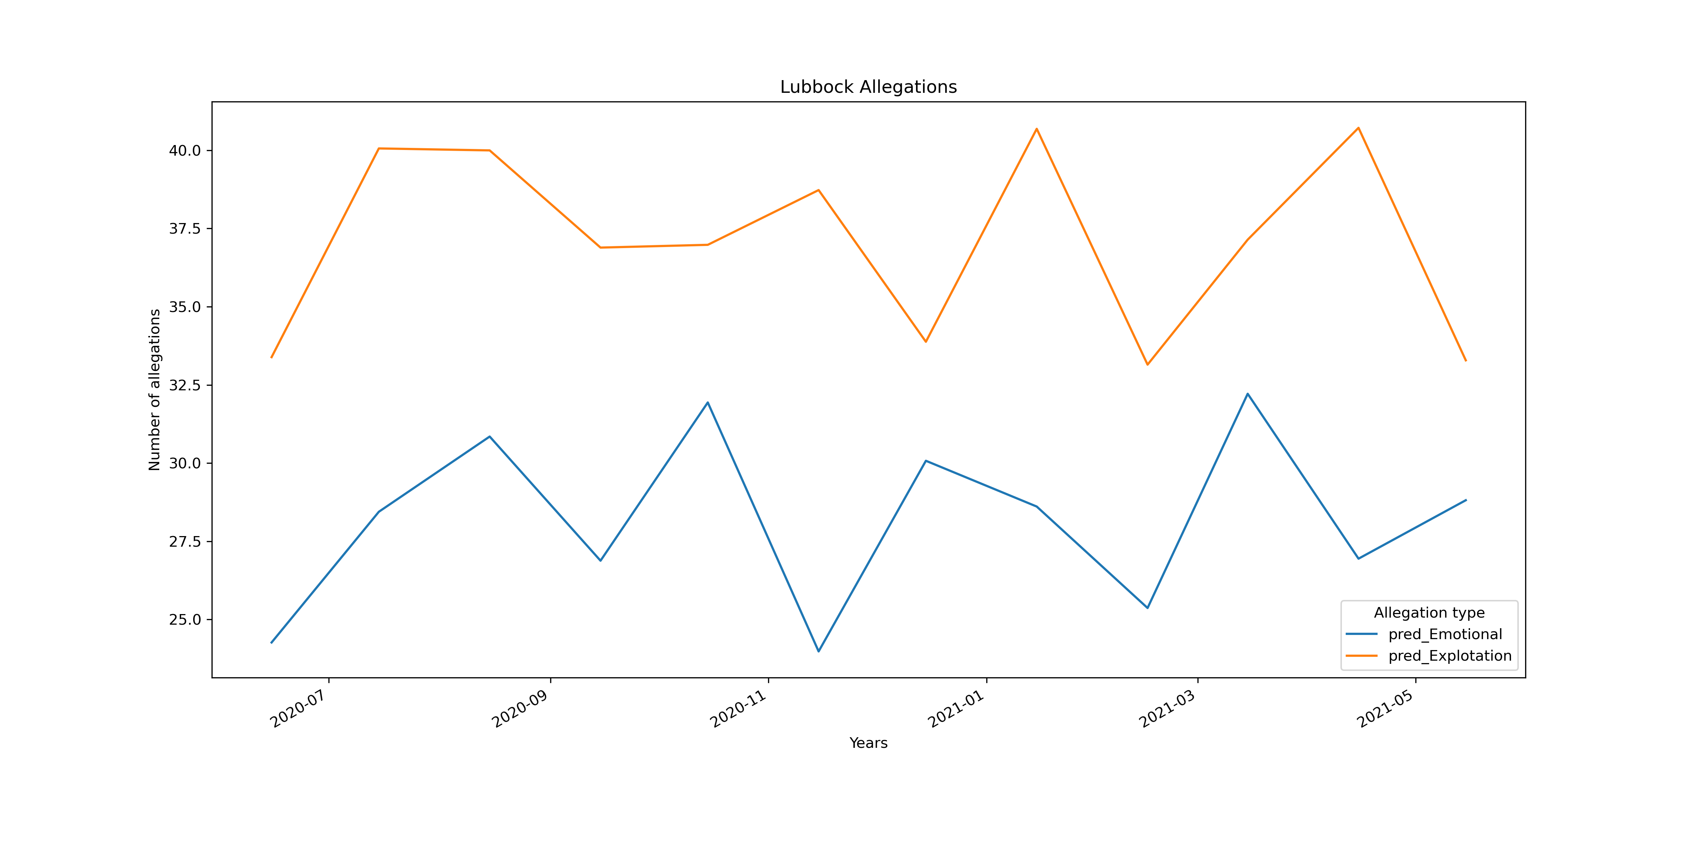
Forecasting

Slide 19
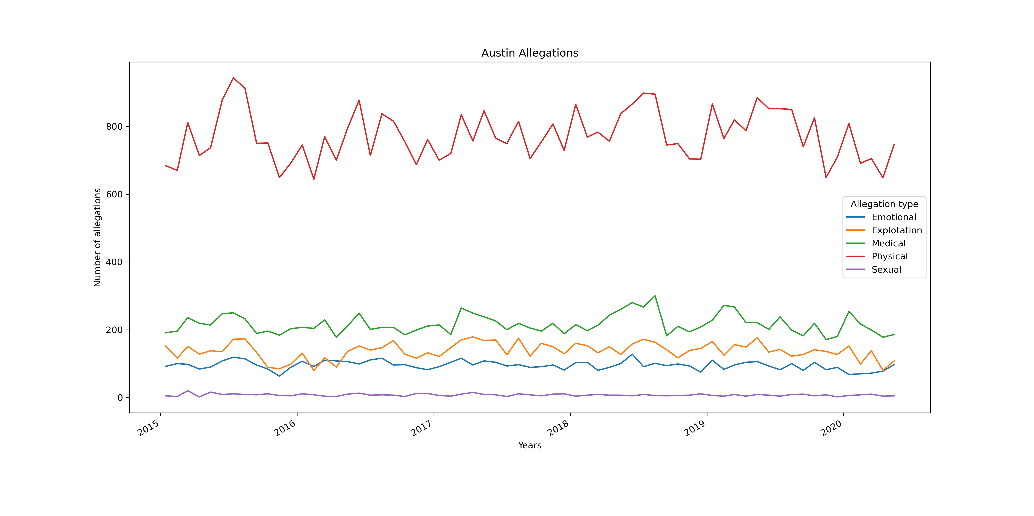
Analyses
Notes:
Lubbock and San Antonio failed the Dickey Fuller test for each allegation type so to make the data stationary we took the log and difference the data. Austin passed so we didn’t have to transform the data. We originally tried to work with the Houston area but we got not get the physical allegation to be stationary even after taking the log and differencing the data.

Slide 20
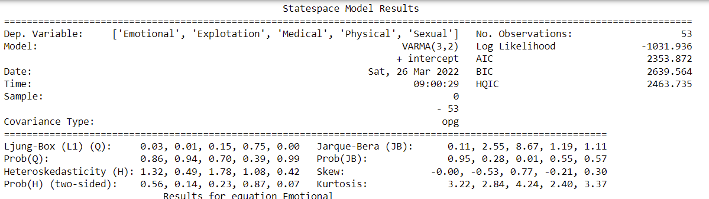
Austin Model Results

Slide 21
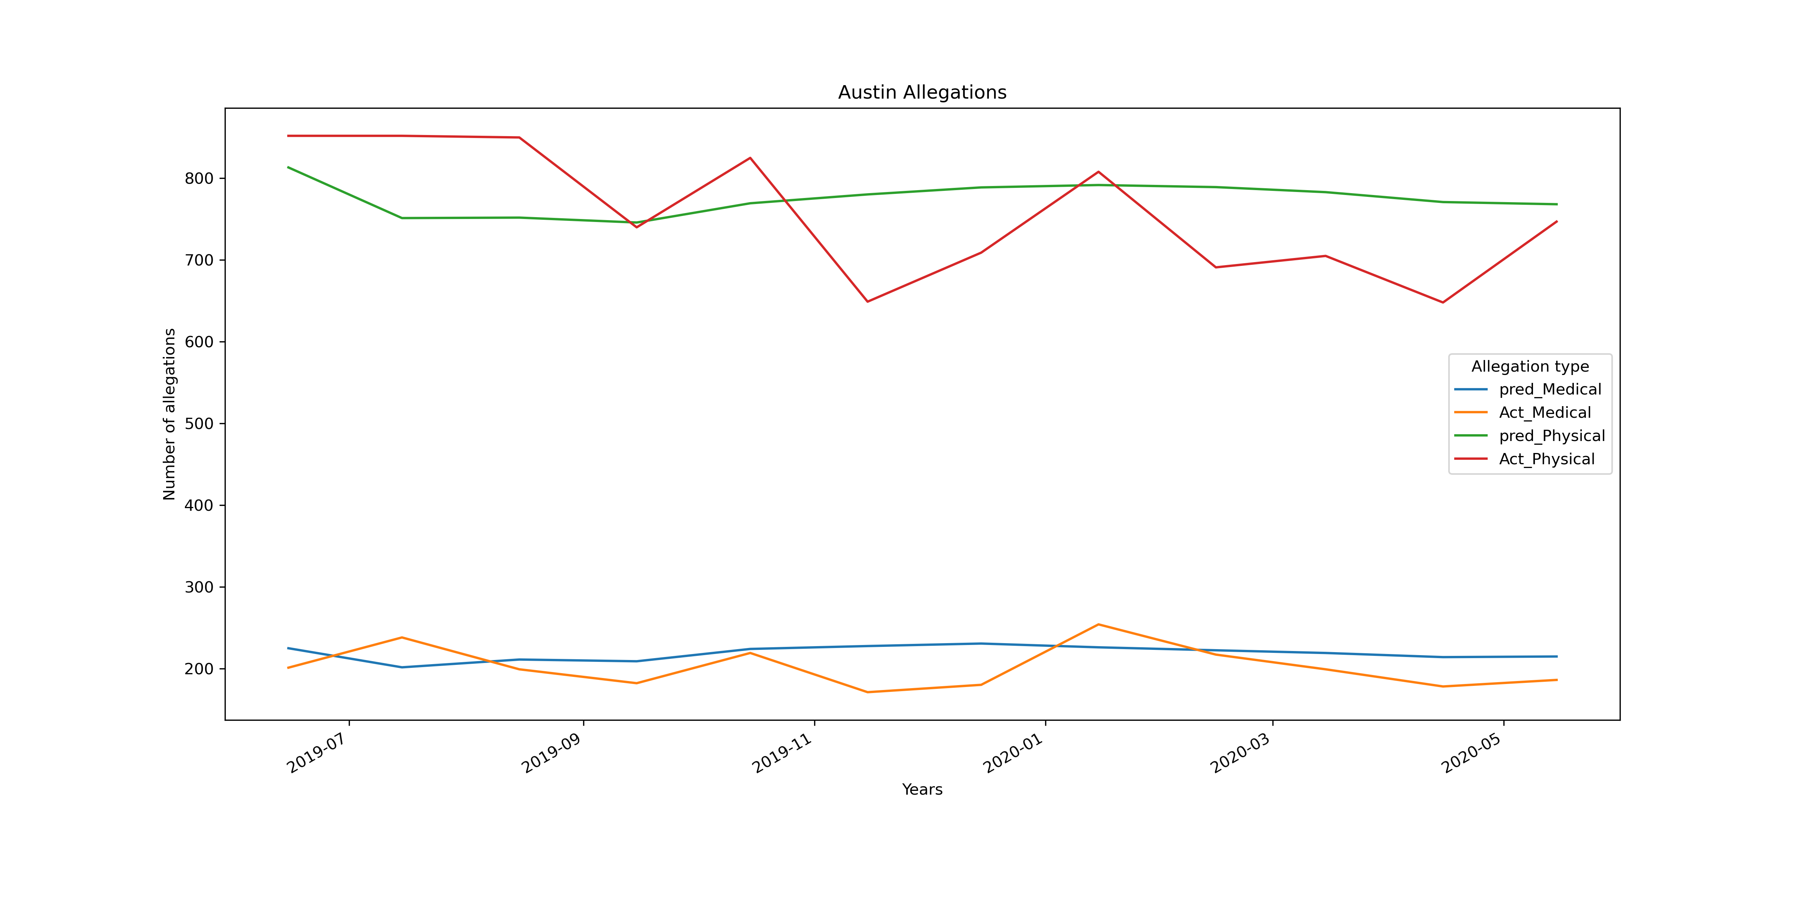
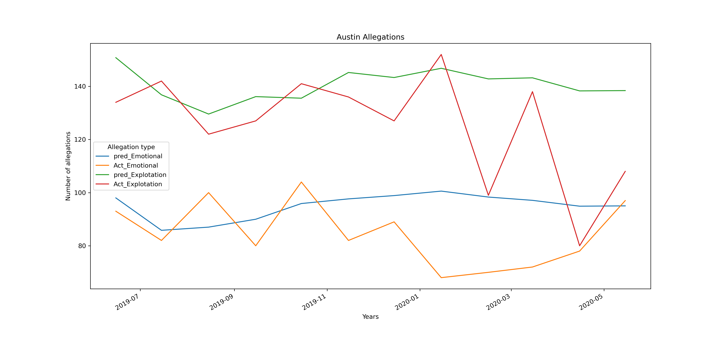
Testing Model Austin

Slide 22
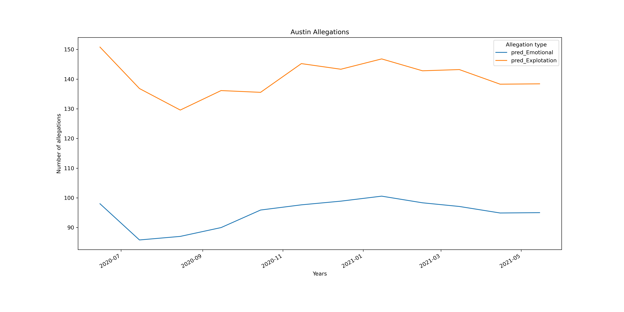
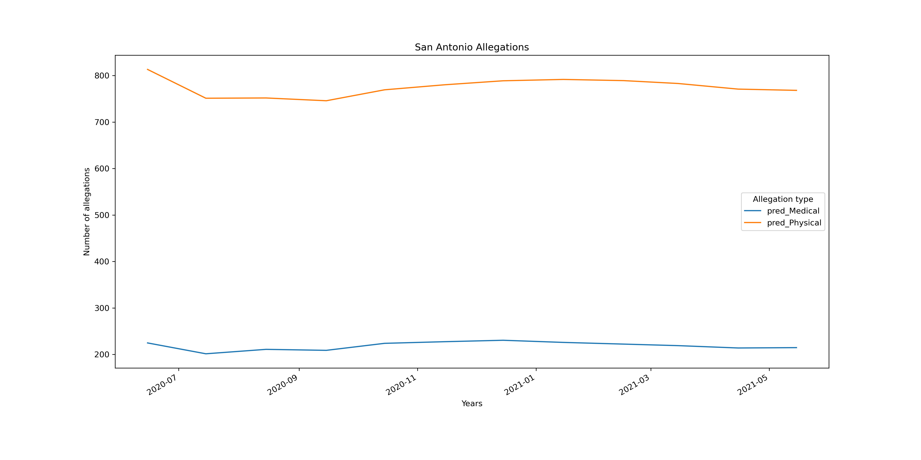
Forecasting

Slide 23
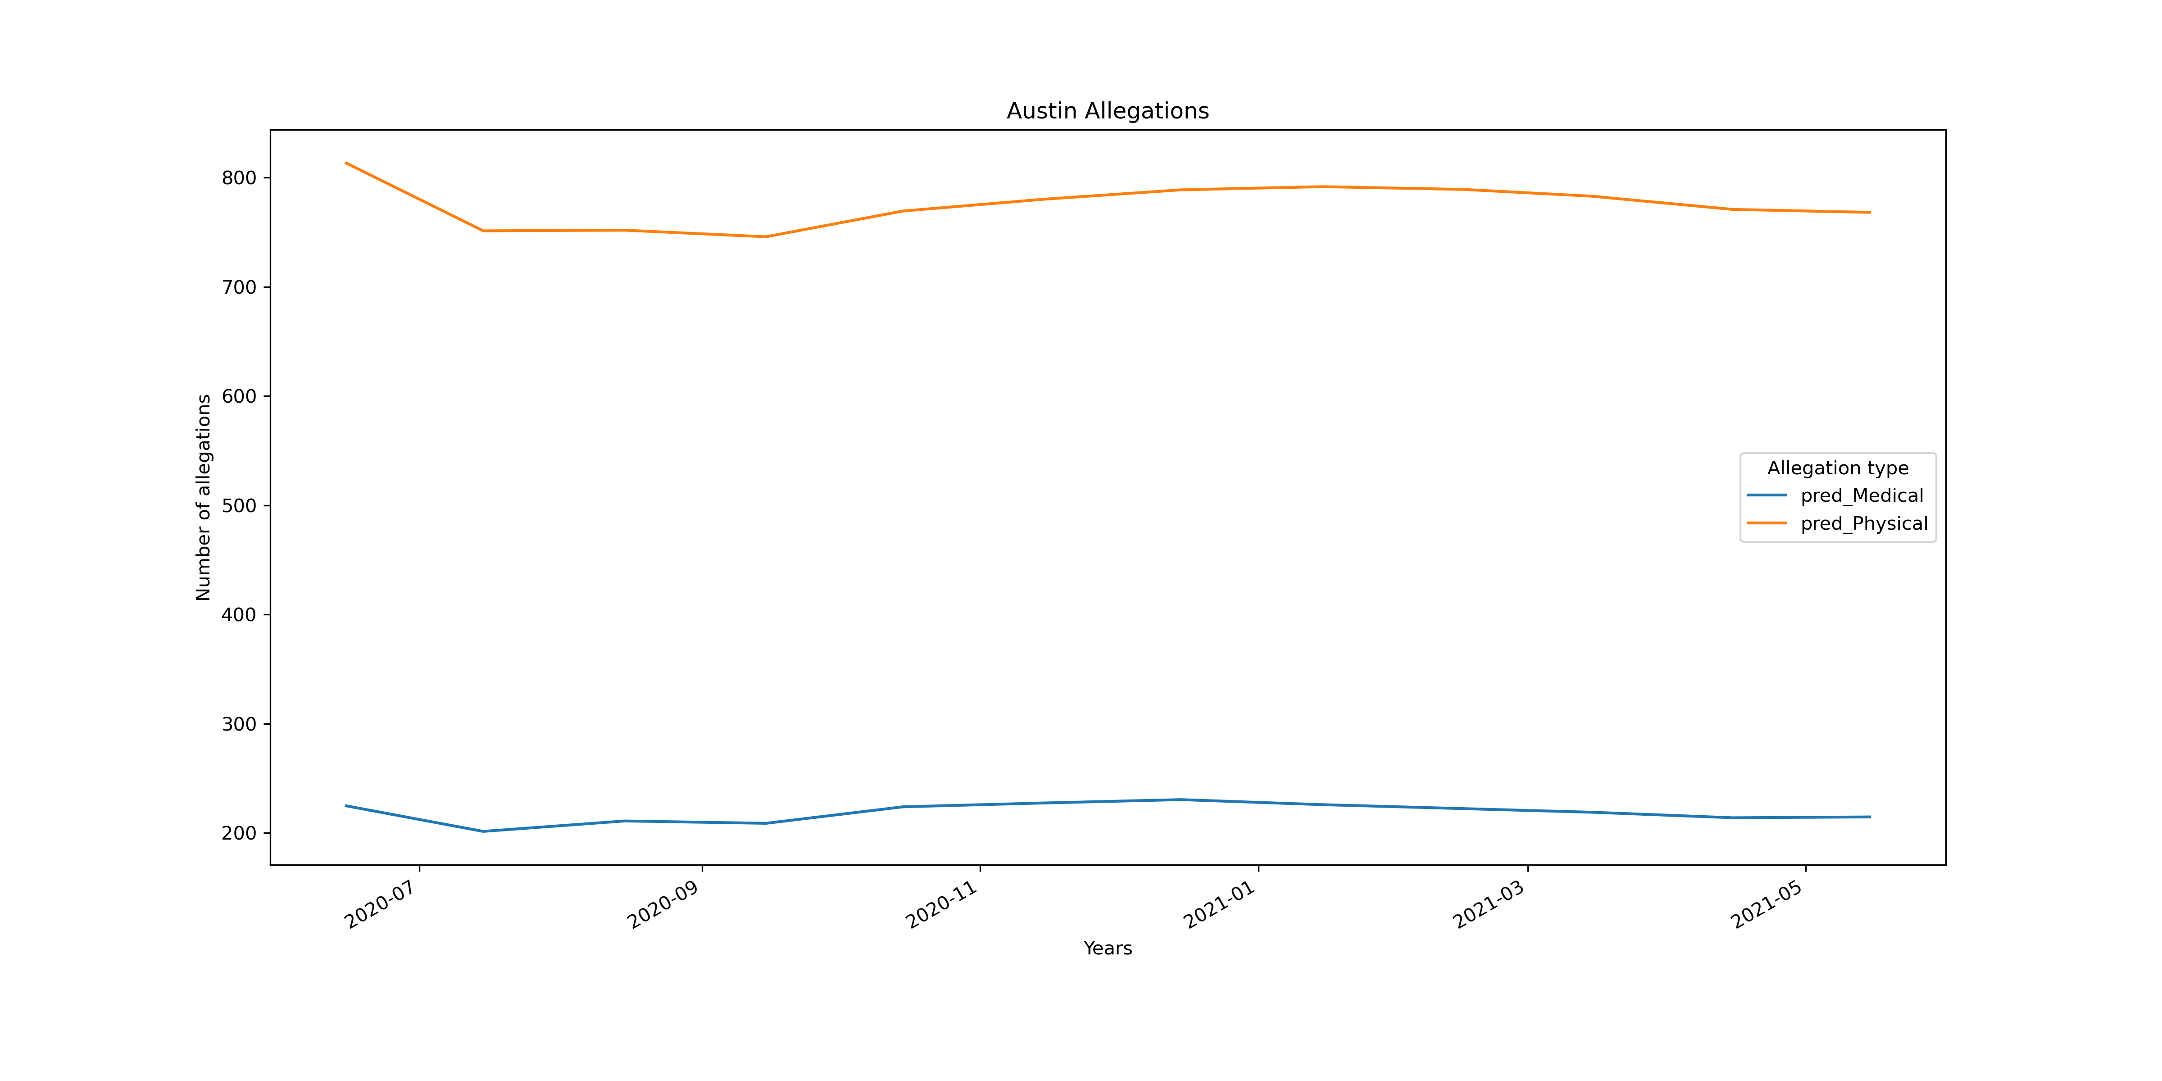
Forecasting

Slide 24
Techniques
Data initial cleaning was done using Excel as it allowed for real-time visual inspection of the data.
Datasets were joined as appropriate, combining data from 5 different datasets. 2 datasets were created to use as references.
Data cleaning required removing nulls, data in incorrect records, and other noise. These instances were a small percentage of the amount of data examined.
We examined Regions 1 (Lubbock), 6 (Houston), 7 (Austin) and 8 (San Antonio). Only Lubbock and Austin are presented here. San Antonio’s results are similar to Austin’s.
Originally, we were going to use the Houston area (Region 6). That did not work out as we could not get the Houston data to be stationary. This prompted us to select Austin (Region 7)
VARMAX modeling was used for analysis, forecasting and graphing those forecasts
plotly was used to create the chloroplast of Texas.

Slide 25
Conclusions
Which areas have the highest need?
As expected, urban areas have the highest needs and the “client base” is continuing to grow. What is interesting is that the intakes or new cases are noy growing as fast as the population.
What is the breakdown of the types/urgency of the cases?
For the regions we explored, physical neglect is the major type of case reported, followed by medical neglect..
Is one ethnicity or gender more likely to need services?
There is no significant differences between women and men. What we did not look at, which should be explored, is what percentage of the eligible population is male and female and if there is/are any cultural biases that would make one gender more likely to ask for assistance than the other. Anecdotally, it appears that women are more likely to accept assistance than men.
Should APS increase staffing?
Whiles there will be increases, we are not predicting a large increase in intakes/cases in the next 12 months. Therefore, we are not recommending a large increase in additional caseworkers. This does assume that current vacant positions are filled.

Slide 26
Questions?

Slide 27
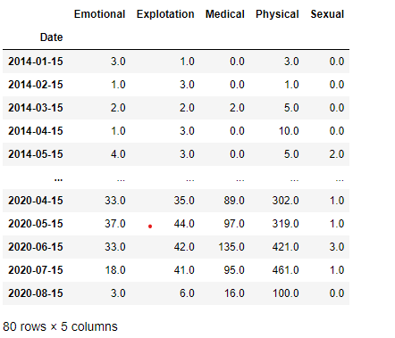
Analyses

Slide 28
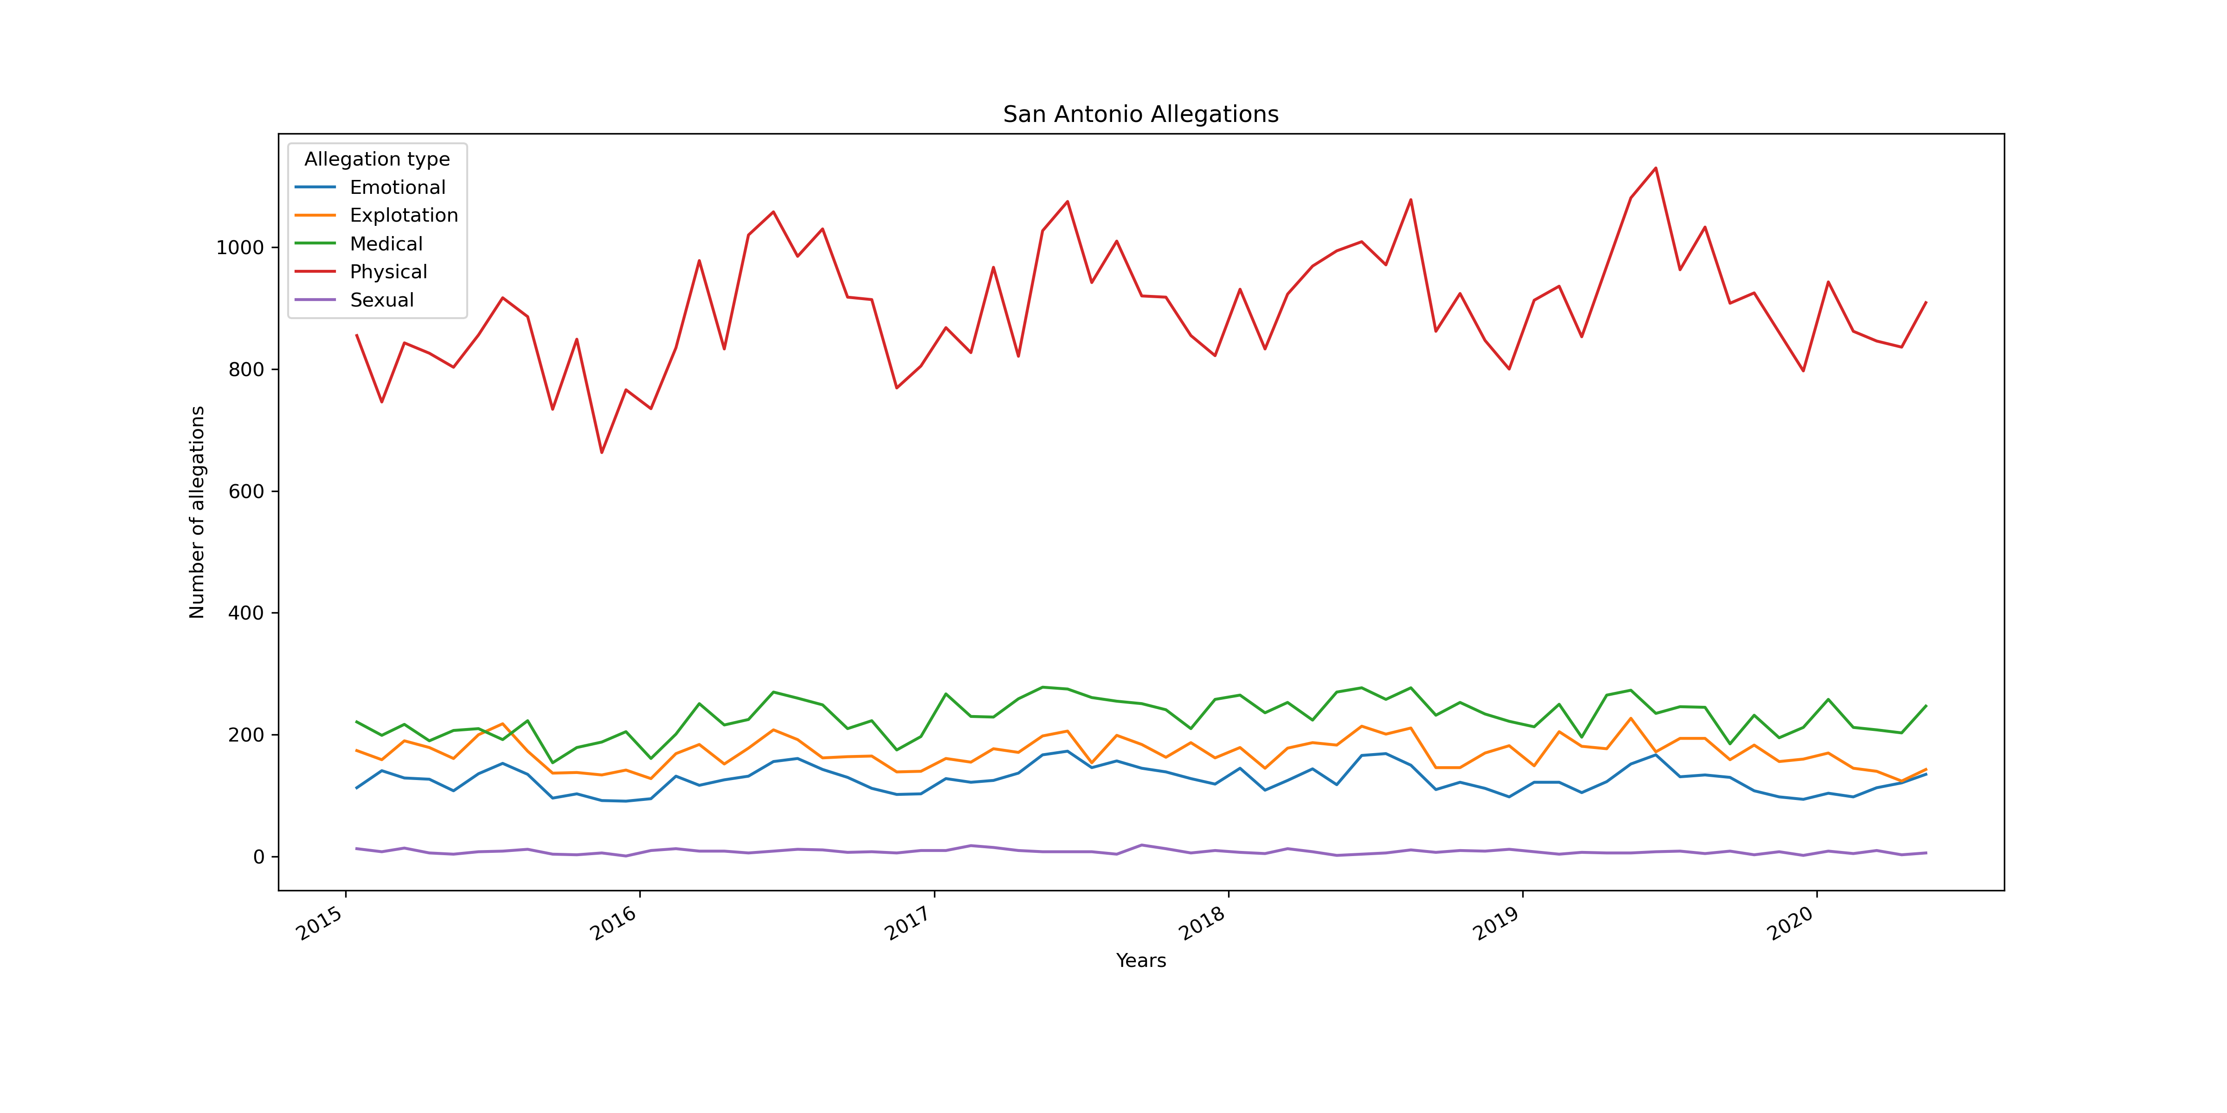
Analyses

Slide 29
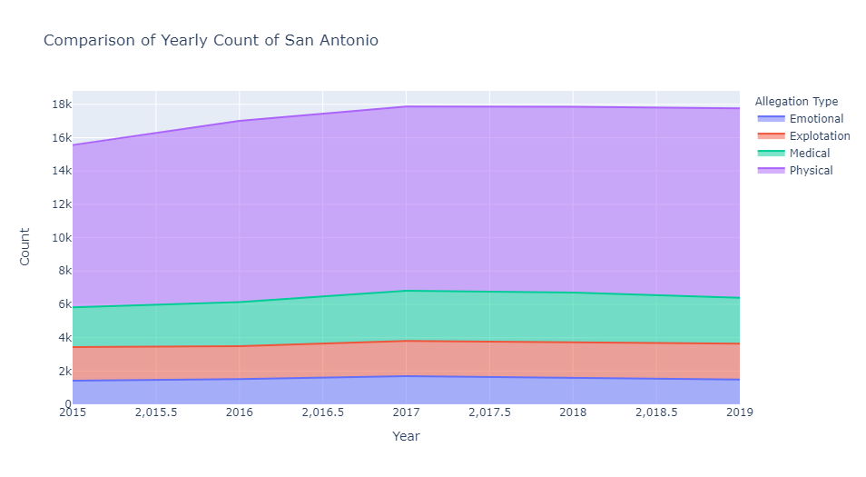
Analysis

Slide 30
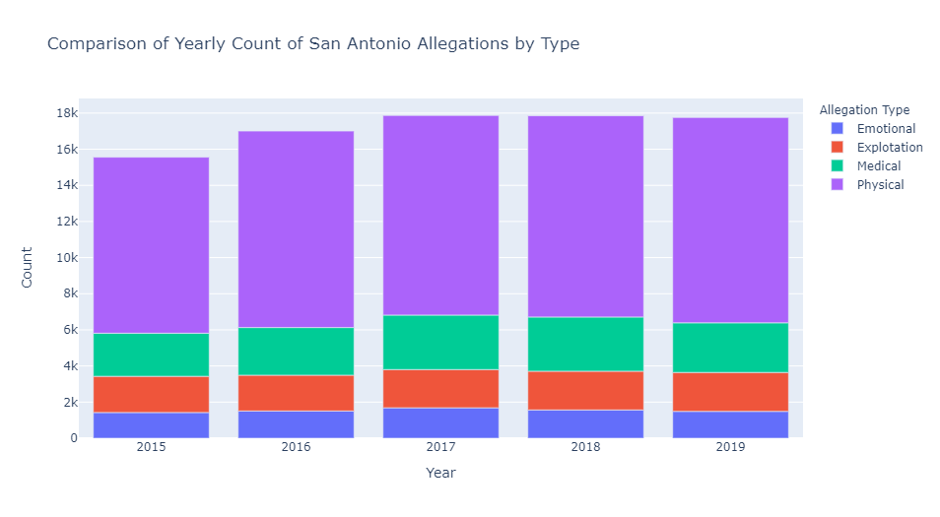
Analysis

Slide 31
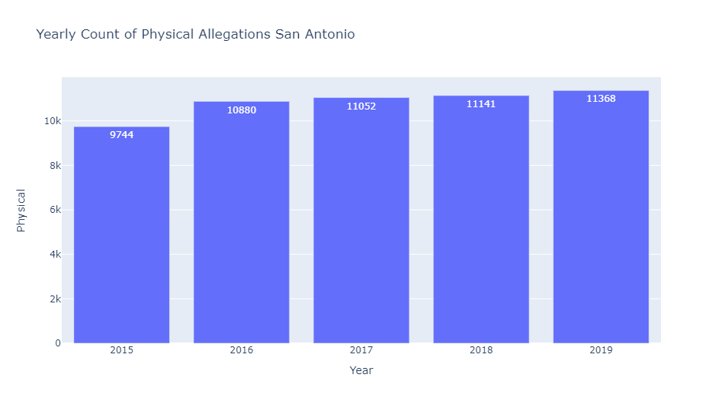
Analysis

Slide 32
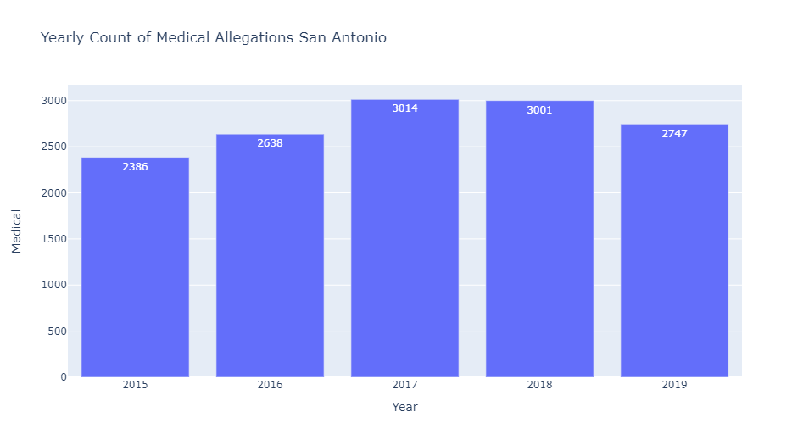
Analysis

Slide 33
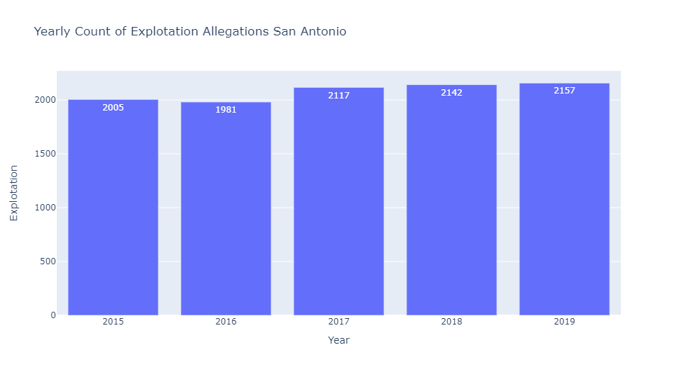
Analysis

Slide 34
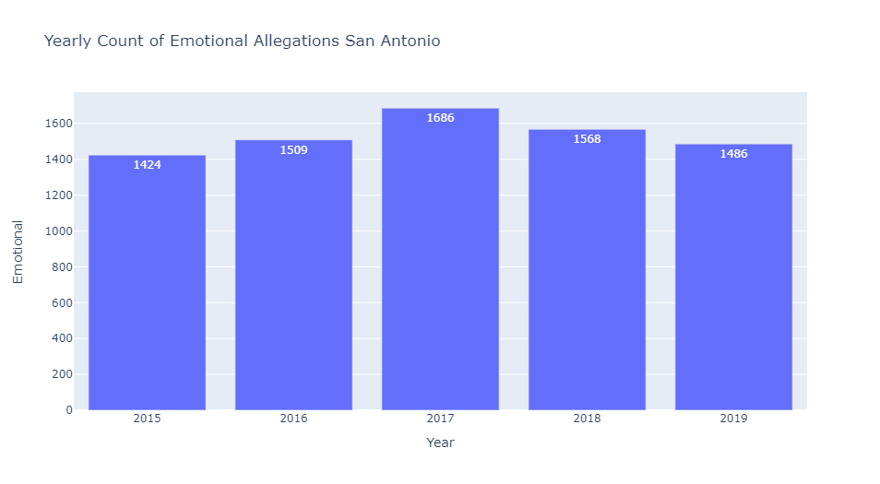
Analysis

Slide 35
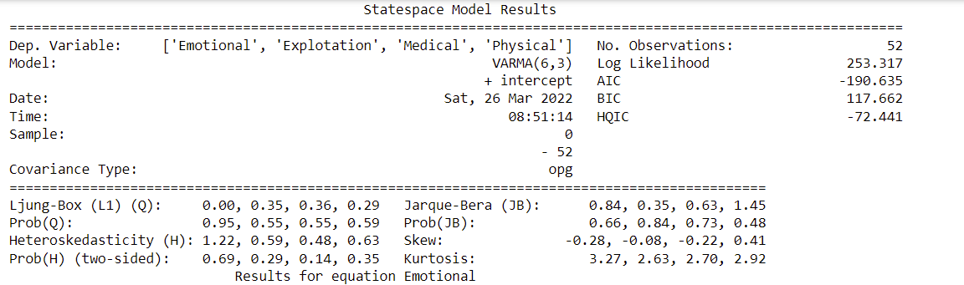
San Antonio Model Results

Slide 36
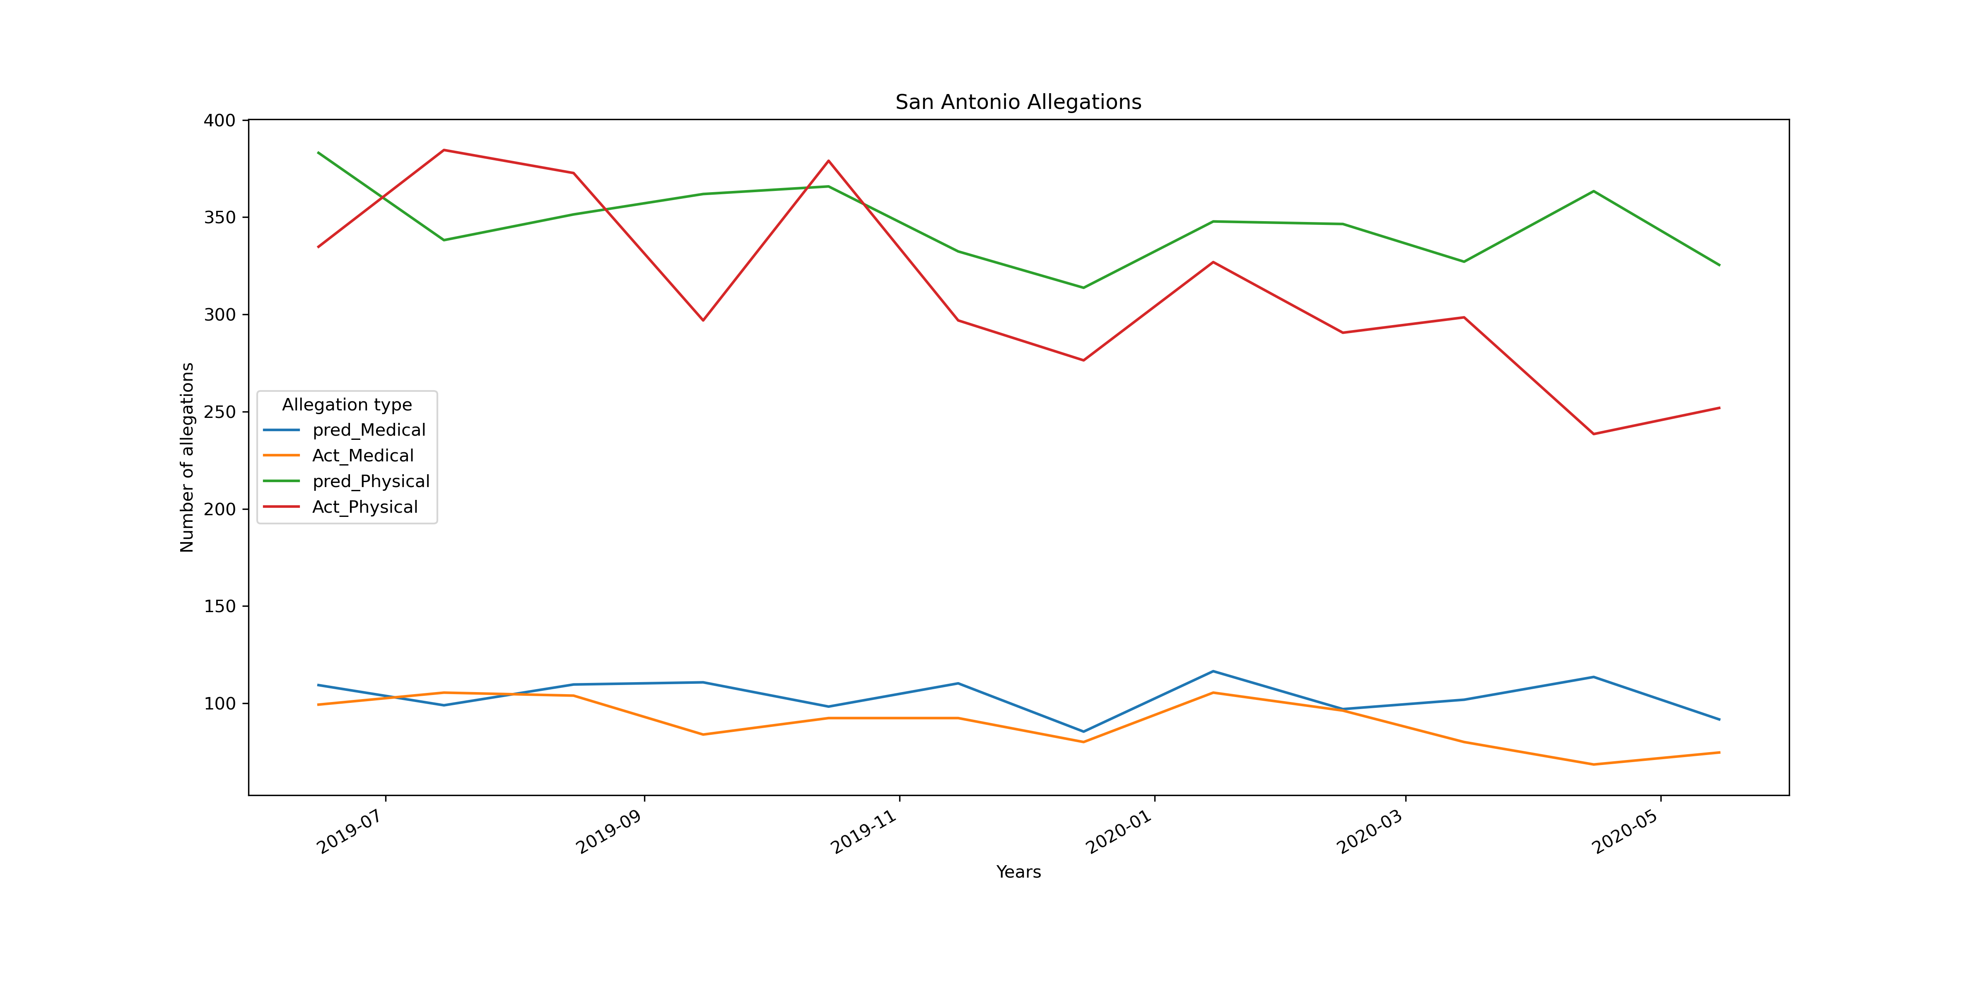
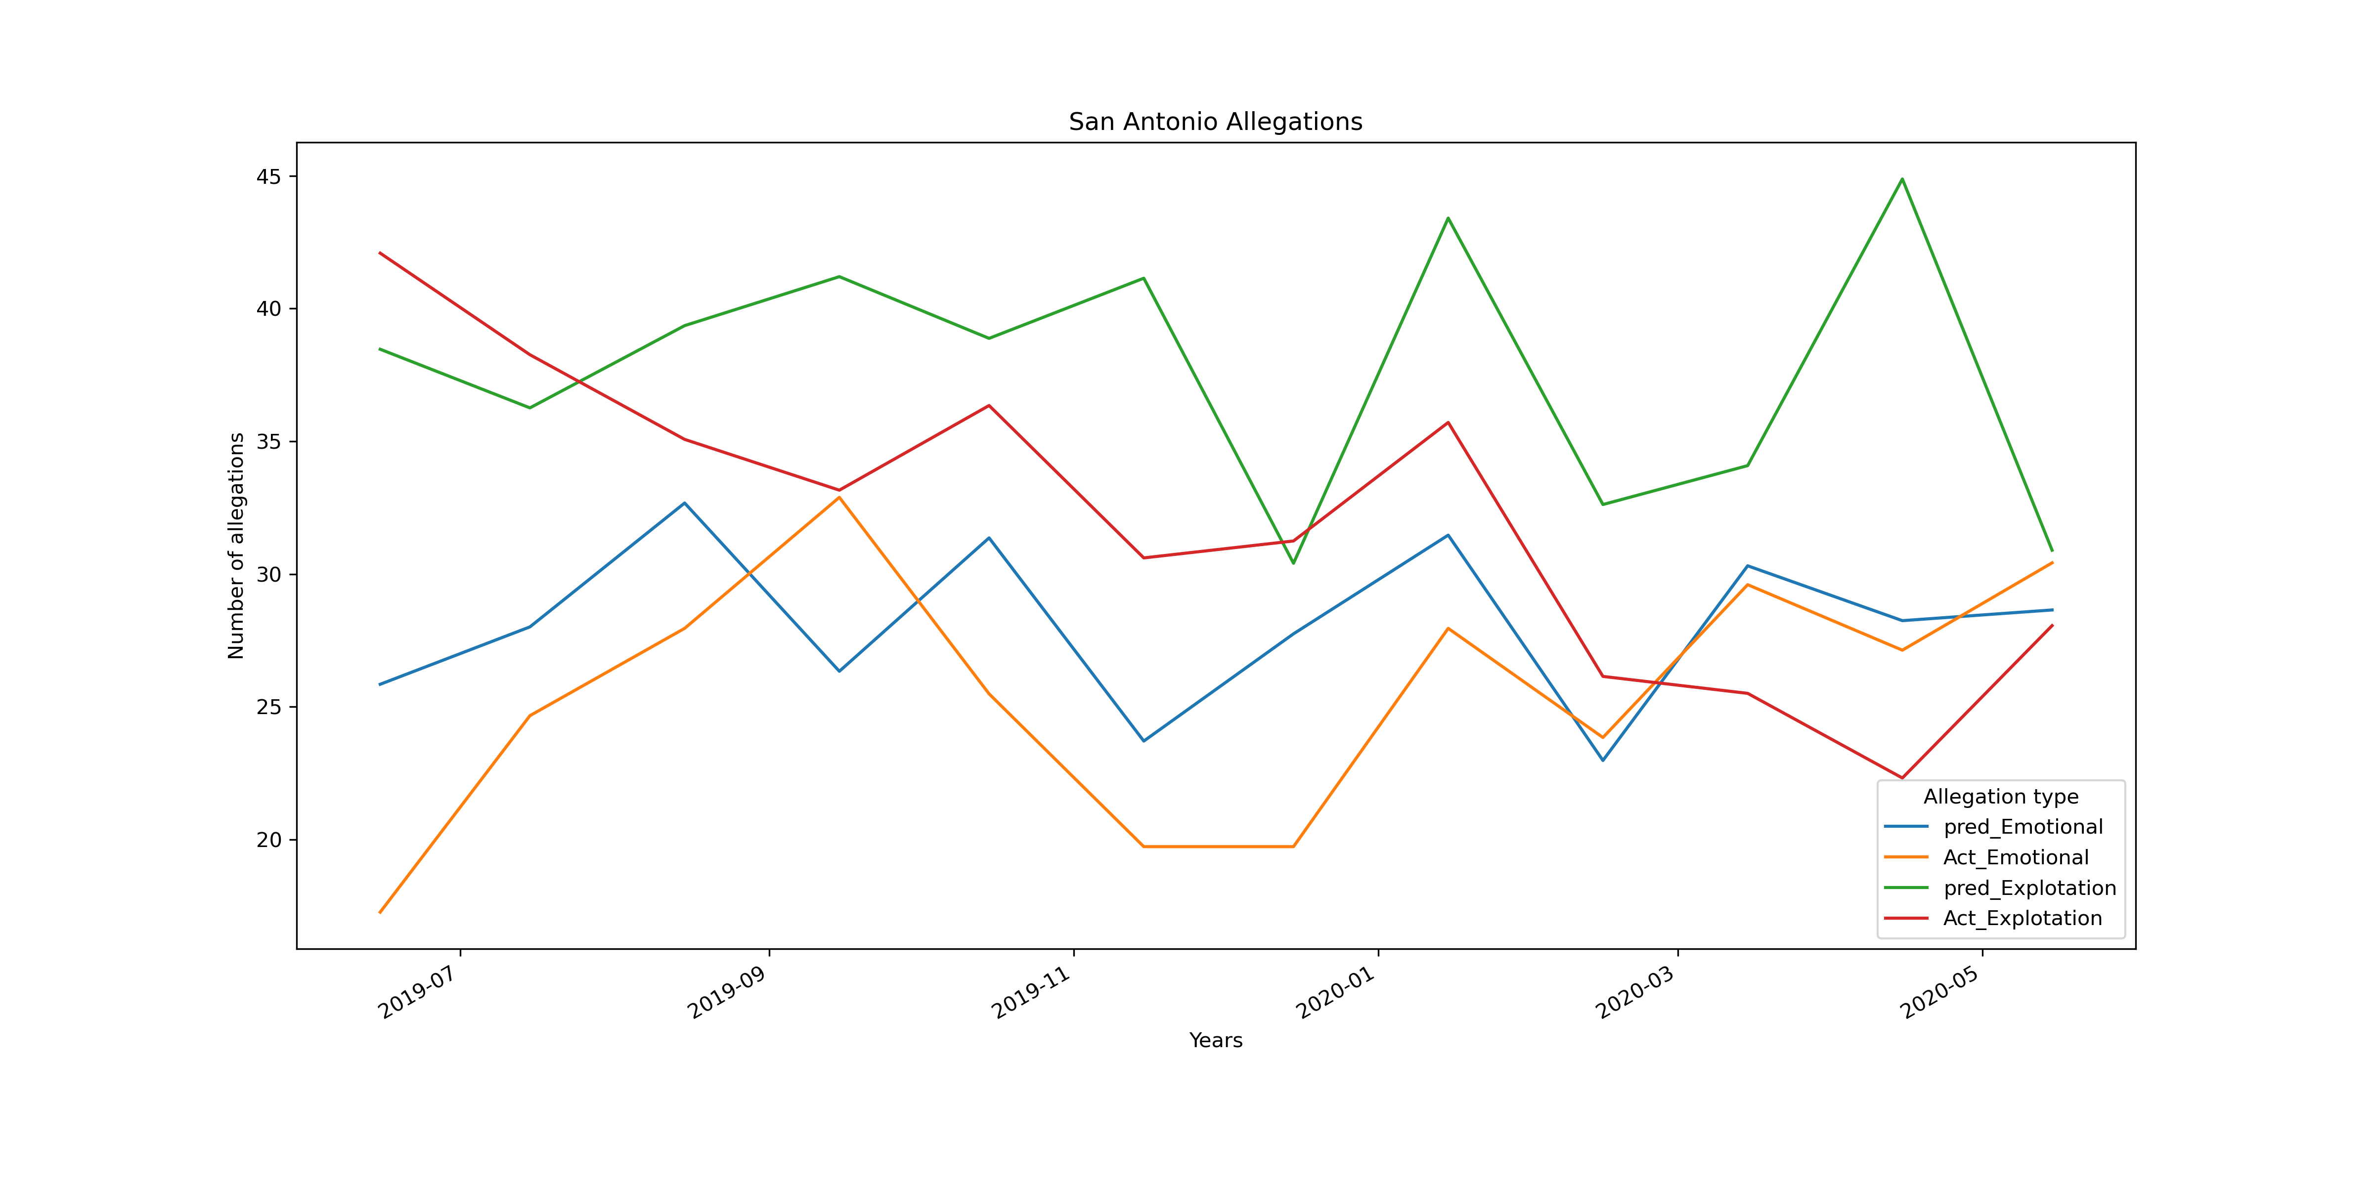
Testing Model San Antonio

Slide 37
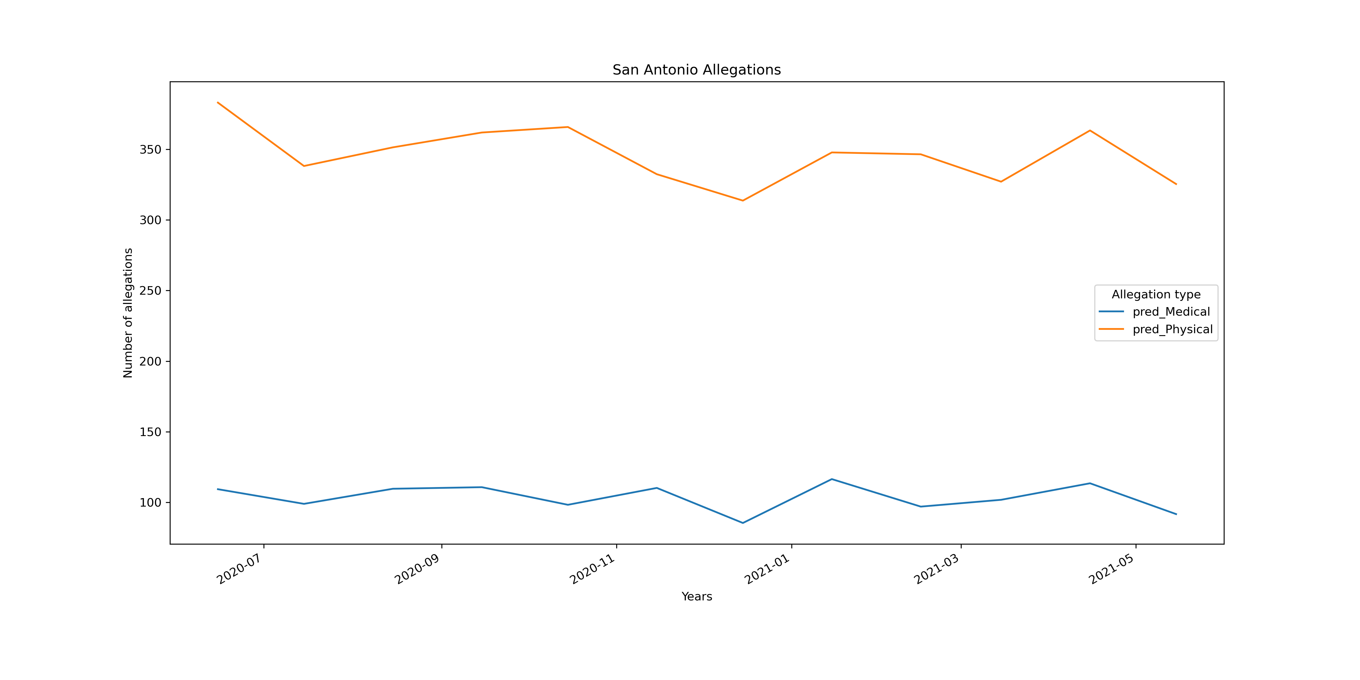
San Antonio Forecasting

Slide 38
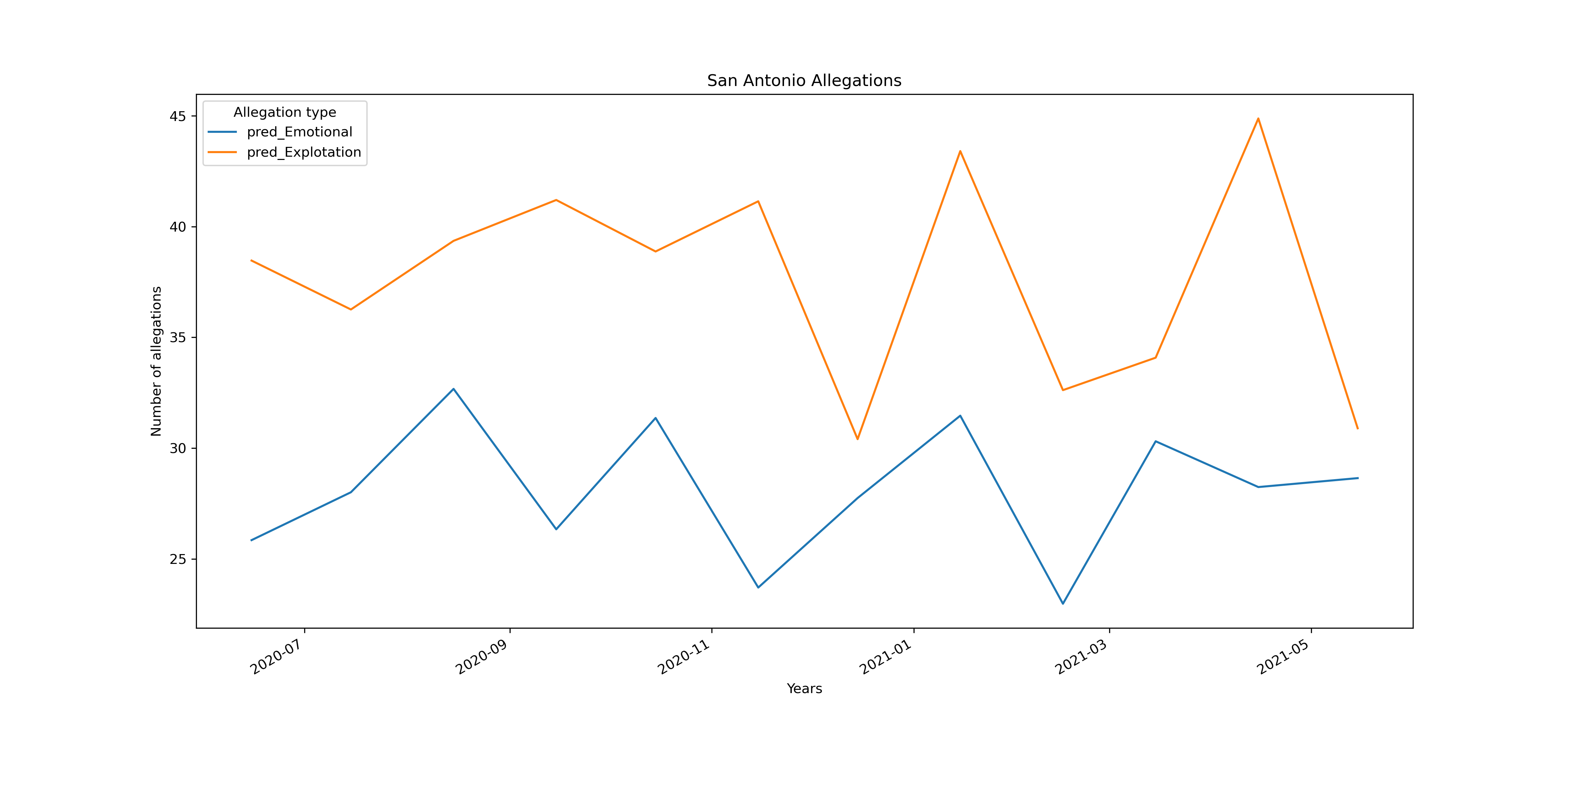
San Antonio Forecasting

